Slide 1
Greedy technique
By Coral S. Schmidt Montilla

Slide 2
Agenda
Introduction to Greedy Algorithms
Description of the Greedy Technique
History of Greedy Algorithms
Advantages and Disadvantages
Greedy vs. Other Techniques
Examples of Greedy Algorithm Applications
Conclusion
References

Slide 3
Introduction to Greedy Algorithms
- Greedy algorithms are fundamental in algorithm design, offering a heuristic approach to optimization problems.
- They prioritize making locally optimal choices at each step, aiming to eventually achieve a globally optimal solution.
- While simple in concept, understanding their intricacies and trade-offs is essential for effective problem-solving.
Notes:
Los algoritmos Greedy son fundamentals para el diseno de algoritmos que ofresen un procedimiento práctico para optimizar los problemas.
Es una prioriodad tomar deciciones optimas a nivel local para lograr una solucion optima.

Slide 4
Description of the Greedy Technique
- Greedy algorithms operate iteratively, making decisions based solely on the information available at each step.
- They employ a "greedy" strategy, prioritizing the option that seems best at the current moment without considering future consequences.
- This approach contrasts with dynamic programming, which stores solutions to subproblems and may revisit decisions based on future information.
Notes:
Greedy opera de forma iterative, sus deciciones son tomadas unicamente con la informacion disponible en cada paso.
La opcion que parece mejor en el momento es priorizada sin mirar las concecuencias. Esto contrasta con la programacion dinamica que almacena soluciones a subproblemas y puede revisar sus decisiones basadas en información futura.

Slide 5
History of Greedy Algorithms
- The roots of greedy algorithms trace back to the 1950’s, primarily in the context of graph algorithms.
- Notable advancements include Prim's and Kruskal's algorithms for minimal spanning trees, which prioritize edges with minimal weights.
- In the 1970s, researchers like Cormen, Rivest, and Stein further developed the theory and applications of greedy strategies.
- Greedy algorithms have since found widespread use in various domains, including networking protocols and optimization problems.
Notes:
Greedy origino en el 1950, primordialmente en el context de algoritmos graficos.
Unos avances notables son los algoritmos de Prim y Kruskal para los minimal spanning trees, que priorizan los bordes con peso minimo.
En los 1970, investigadores como Cormen Rivest y Stein siguieron mejorando la Teoria y aplicaciones de la estrategia Greedy.
De ahi entonses se an encontrado muchos uso en varios dominios, incluyento los protocolos de networking y problemas de optimizacion.

Slide 6
Advantages and Disadvantages
Advantages:
Simplicity:
Greedy algorithms are often straightforward to implement and understand, making them accessible to programmers at all levels.
Efficiency:
They typically have lower time complexities compared to other techniques, making them suitable for large datasets and real-time applications.
Applicability:
Greedy algorithms can efficiently solve a wide range of optimization problems, from scheduling tasks to optimizing resource allocation.
Disadvantages:
Suboptimality:
Greedy algorithms may not always find the optimal solution, as they prioritize immediate gains without considering long-term consequences.
Local Optimization:
The locally optimal choices made by greedy algorithms may not lead to a globally optimal solution, resulting in suboptimal outcomes.
Input Sensitivity:
The order in which elements are considered can significantly impact the final solution, leading to variability in results.
Notes:
Advantages
Simple – son faciles de implementar que es facil de entender para programadores de todos niveles.
Efficiente – Tiene una menor complejidad de tiempo al contrario de otras tecnicas.
y su Aplicabilidad – resuelven eficientemente la mayoria de los problemas de optimizacion
Disadvantages
Suboptimalidad – no siempre encuentran la solucion optima, porque priorizan las ganancias immediatas.
Optimizacion Local
Input sensitivity - El orden en el que se consideran los elementos puede afectar significativamente la solución final, lo que lleva a la variabilidad en los resultados.

Slide 7
Greedy vs. Other Techniques
Greedy Algorithms
Focus on locally optimal choices without revisiting decisions. They offer simplicity and efficiency but may yield suboptimal solutions.
Dynamic Programming
Store solutions to subproblems and optimize decisions based on future information. While more complex, dynamic programming guarantees optimal solutions.
Divide and Conquer
Divide problems into smaller subproblems, solve independently, and combine solutions. This approach balances efficiency and optimality but can be slower.
Notes:
Greedy – su goal es concentrarse en las opciones optimas a nivel local sin tener que revisar decisions. Y es simple y eficiente.
Dynamic - Almacene soluciones a subproblemas y optimisa las decisiones en función de la información futura. Y es más compleja y garantiza soluciones óptimas.
Divide and conquer – divide problemas en problemas mas pequenos que se resuelven independientemente. Es mas lento pero balancea eficiencia y optimalidad

Slide 8
Examples of Greedy Algorithm Applications

Slide 9
Fractional Knapsack:
Maximizing the value of items within a knapsack's capacity, allowing fractional inclusion of items.
How it works:
Imagine you have a backpack with a limited capacity, and you're going on a trip. You want to take items with you to maximize the value of what you're carrying. Each item has both a weight and a value. In the fractional knapsack problem, you're allowed to take fractions of items if that helps you maximize the value.
For example, if you have a backpack that can carry 50 pounds, and you have items like a laptop (worth $60, weighs 10 pounds), a camera (worth $100, weighs 20 pounds), and a tent (worth $120, weighs 30 pounds), you could take part of the tent to fill up the remaining space in the backpack, even if you can't fit the whole tent. This way, you get the most value out of the space you have.

Slide 10
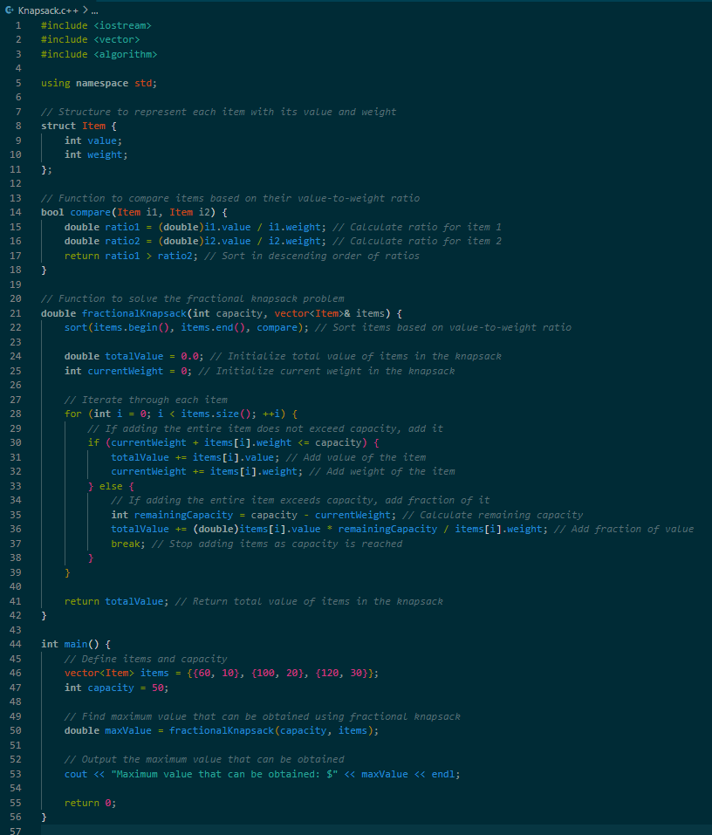
Code example

Slide 11
Dijkstra's Algorithm
Finding the shortest path from a source vertex to all other vertices in a weighted graph, prioritizing paths with minimal distances.
How it works:
Imagine you're planning a road trip, and you want to find the shortest route from your starting point to all the destinations you want to visit. Dijkstra's algorithm helps you do this efficiently. It works by starting at your current location and checking the distances to all nearby destinations. Then, it picks the closest destination and repeats the process from there, updating the distances as it goes.
For example, if you're in a city(vertices) and you want to find the shortest routes to all neighboring cities(vertices), Dijkstra's algorithm would help you do this by iteratively choosing the closest city(vertices) until you've checked them all.

Slide 12
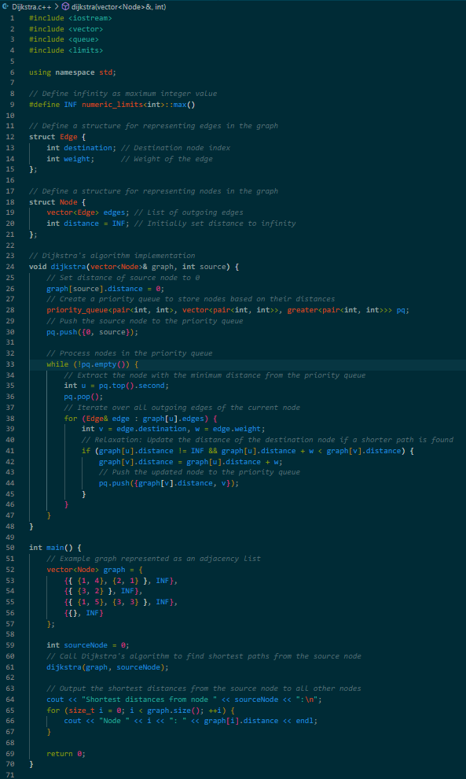
Code example

Slide 13
Kruskal's Algorithm
Constructing the minimum spanning tree of a weighted graph by iteratively selecting edges with minimal weights.
How it works:
Imagine you have a map of cities with roads connecting them, and you want to build the shortest network of roads that connects all the cities without any loops (a loop would mean you're wasting resources building unnecessary roads). Kruskal's algorithm helps you do this by starting with the shortest roads and gradually adding longer ones while making sure you don't create loops.
For example, if you have a map with cities and the distances between them, Kruskal's algorithm would help you find the shortest network of roads that connect all the cities without any unnecessary detours or loops.

Slide 14
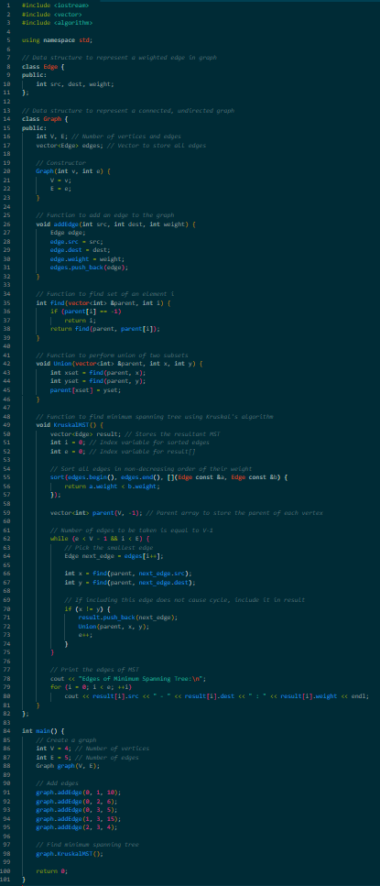
Code example

Slide 15
Conclusion
Greedy algorithms offer a valuable approach to optimization problems, balancing simplicity and efficiency.
While they may not always yield the optimal solution, understanding their advantages, disadvantages, and applications is crucial for effective problem-solving.
By recognizing the trade-offs involved and leveraging their strengths, programmers can harness the power of greedy algorithms in various domains.
Notes:
Greedy ofrece un enfoque valioso para los problemas de optimizacion, balanceando simplicidad y eficiencia.
No siempre va a tener una solucion optima, entendiendo sus advantages, disadvanteges y aplicaciones es crucial para resolver problemas efectivamente.
Al reconocer las compensaciones involucradas y aprobechar sus fuerzas, programadores pueden aprovechgar el poder de los algoritmos greedy en varios dominios

Slide 16
References
Hrushikesh sohoni. “Greedy Algorithm - Hrushikesh Sohoni - Medium.” Medium, Medium, 21 May 2021, hrishisohoni.medium.com/greedy-algorithm-dec27a898d24. Accessed 18 Apr. 2024.
GeeksforGeeks. “Greedy Algorithms.” GeeksforGeeks, GeeksforGeeks, 7 Feb. 2024, www.geeksforgeeks.org/greedy-algorithms/. Accessed 18 Apr. 2024.
GeeksforGeeks. “Difference between Greedy Algorithm and Divide and Conquer Algorithm.” GeeksforGeeks, GeeksforGeeks, 4 Nov. 2022, www.geeksforgeeks.org/difference-between-greedy-algorithm-and-divide-and-conquer-algorithm/. Accessed 18 Apr. 2024.
GeeksforGeeks. “Fractional Knapsack Problem.” GeeksforGeeks, GeeksforGeeks, 23 Mar. 2016, www.geeksforgeeks.org/fractional-knapsack-problem/. Accessed 18 Apr. 2024.
GeeksforGeeks. “What Is Dijkstra S Algorithm? Introduction to Dijkstra S Shortest Path Algorithm.” GeeksforGeeks, GeeksforGeeks, 10 Mar. 2023, www.geeksforgeeks.org/introduction-to-dijkstras-shortest-path-algorithm/. Accessed 18 Apr. 2024.
‌GeeksforGeeks. “Kruskal S Minimum Spanning Tree (MST) Algorithm.” GeeksforGeeks, GeeksforGeeks, 30 Oct. 2012, www.geeksforgeeks.org/kruskals-minimum-spanning-tree-algorithm-greedy-algo-2/. Accessed 18 Apr. 2024.
GeeksforGeeks. “Dynamic Programming or DP.” GeeksforGeeks, GeeksforGeeks, 9 Feb. 2024, www.geeksforgeeks.org/dynamic-programming/. Accessed 18 Apr. 2024.

